Slide 1
PORTFOLIO CASE STUDY · CUSTOMER DATA
Customer Behavior Analysis
From 3,900 purchases to evidence-led business decisions.
Python
SQL
Power BI
Notes:
Introduce this as a recruiter-ready case study: a customer dataset translated into clear metrics, visual storytelling and business recommendations.

Slide 2
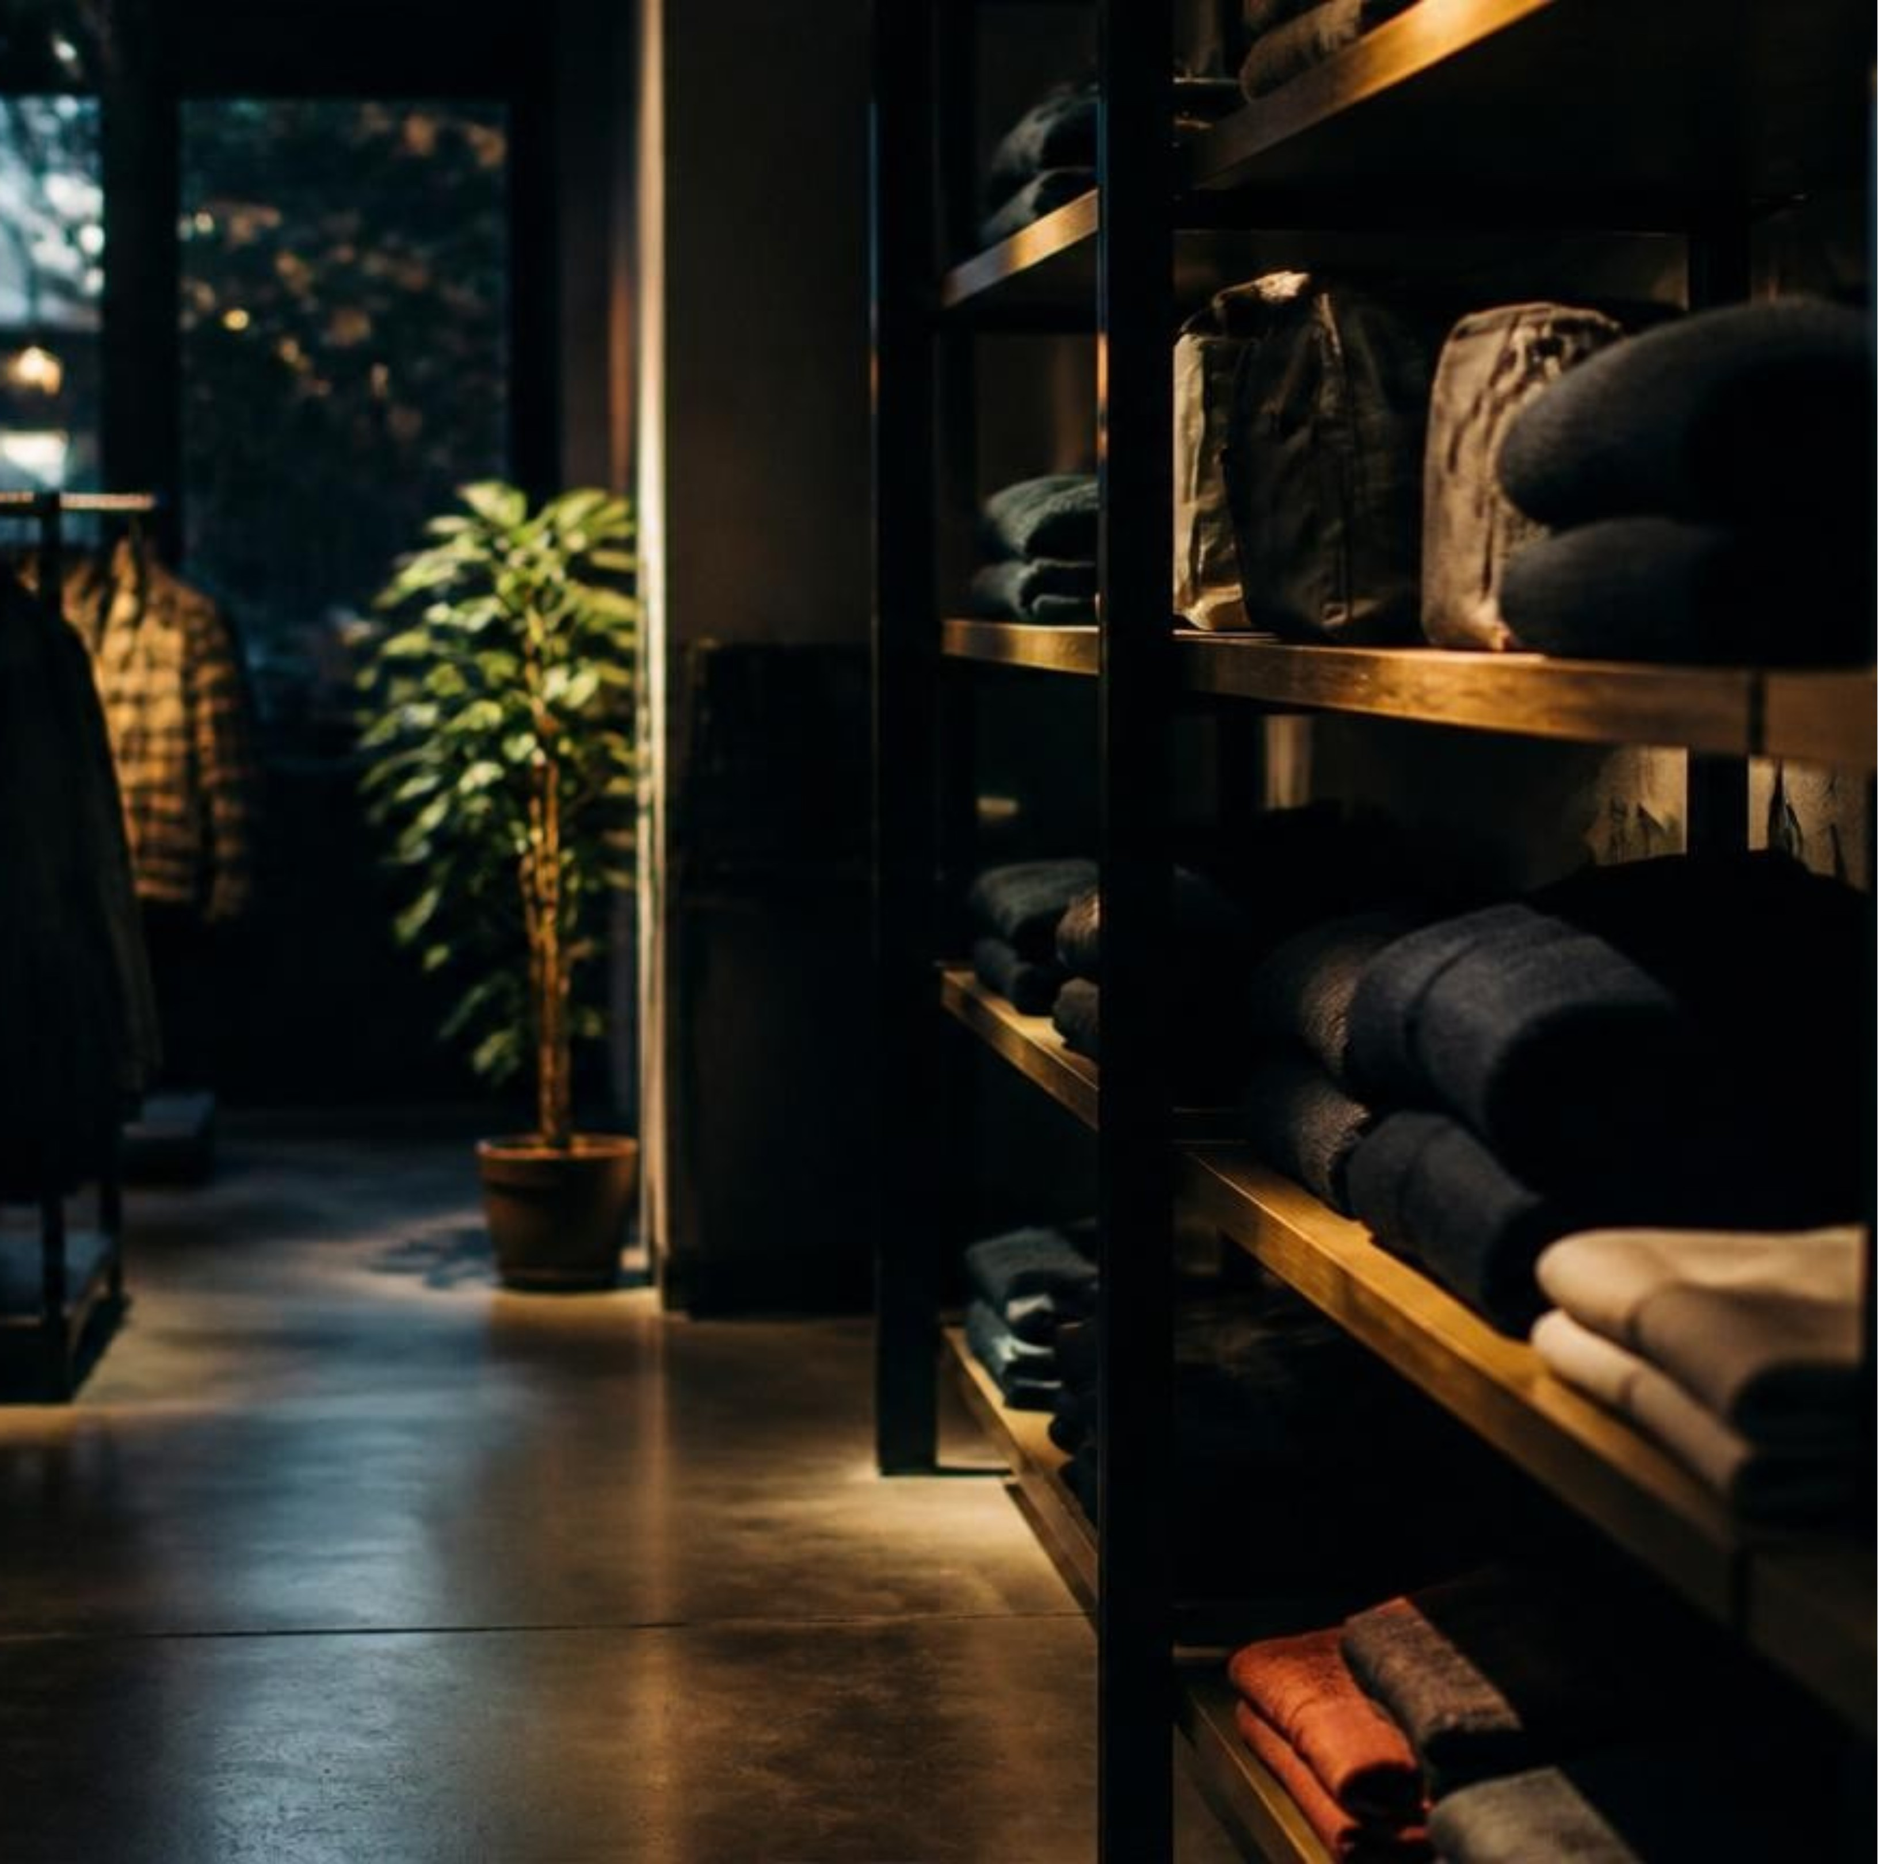
PROJECT FRAME
A 3,900-row dataset turns into a recruiter-ready case study
Business lens: understand revenue mix, customer loyalty, subscription behavior, discount exposure and delivery choice
1
2
Toolkit: SQL aggregation, conditional logic, window functions and customer segmentation
3
Output: a visual analysis designed to move from evidence to action, not just show a dashboard
Notes:
Frame the work in three parts: the business questions, the SQL toolkit and the output standard. The goal is movement from evidence to action.

Slide 3
01 · SCALE
The headline is scale: $233,081 in observed revenue
3,900
Mix already has a shape
$233k
purchases
Clothing leads at $104,264, followed by Accessories at $74,200.
OBSERVED REVENUE
$59.76
A CLEAN, AUDITABLE BASE FOR THE ANALYSIS.
average purchase amount
Notes:
Lead with the size of the observed base. Then establish the audit trail: 3,900 purchases, an average purchase amount of $59.76 and a category mix led by Clothing.

Slide 4
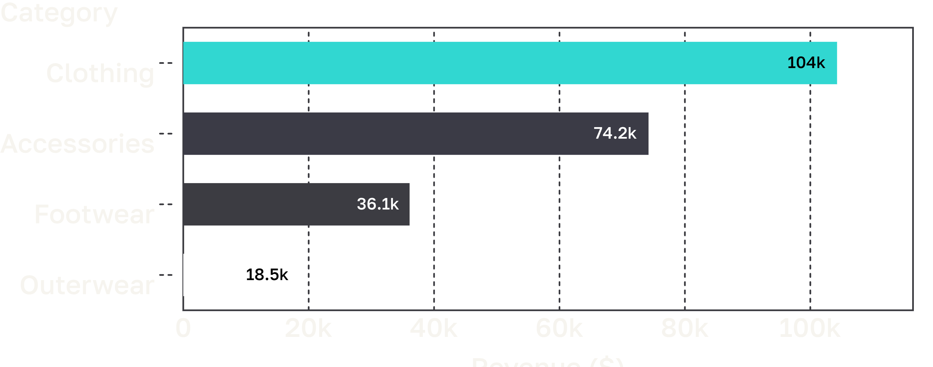




02 · REVENUE MIX
Clothing drives the business, but Accessories is the second engine
45%
Clothing's share of observed revenue.
32%
Accessories' share.
CLOTHING
ACCESSORIES
FOOTWEAR
OUTERWEAR
Notes:
Read the bars from top to bottom. Clothing is the clear lead, but Accessories is substantial enough to be treated as a second engine rather than a supporting category.

Slide 5
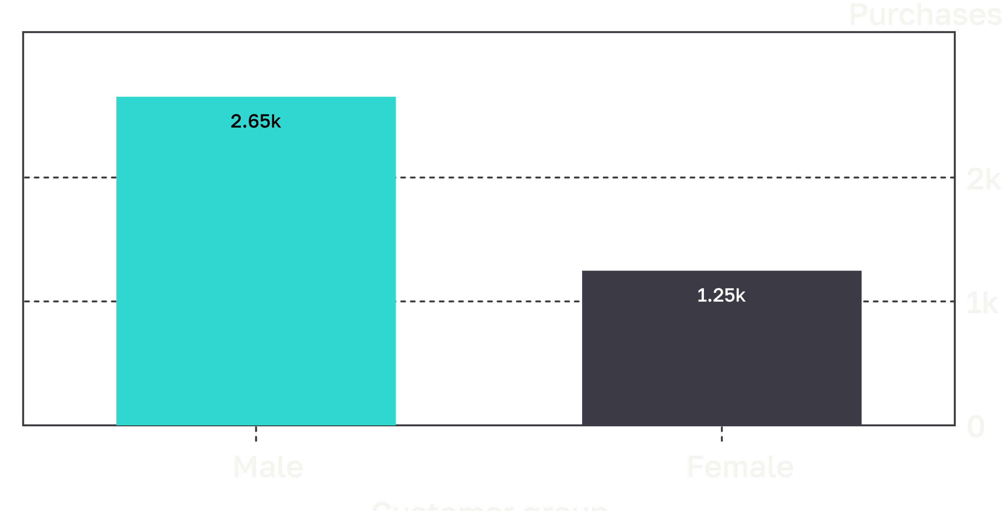
03 · CUSTOMER MIX
The gender split is large, but it is a mix signal, not a value judgment
2,652 vs 1,248
Male customers contribute $157,890; female customers contribute $75,191.
AVERAGE PURCHASE AMOUNT IS NOT THE STORY. THE OBSERVED DIFFERENCE IS PRIMARILY CUSTOMER MIX.
Notes:
Use the chart to show volume, then add the revenue figures. The interpretation is deliberately careful: this is an observed mix signal, not a value judgment.

Slide 6
04 · SUBSCRIPTION
Subscription is not yet translating into higher spend
AVERAGE PURCHASE AMOUNT
$59.49
Volume explains the revenue gap
Subscribers
Subscribers represent 1,053 purchases. Non-subscribers represent 2,847.
Test subscription on retention, frequency or margin rather than assuming it lifts ticket size.
$59.87
Non-subscribers
Notes:
The average tickets are nearly identical. The revenue difference comes from purchase volume, so the next subscription question should focus on retention, frequency or margin.

Slide 7

05 · PRODUCT SIGNALS
Product demand is broad, so ratings help prioritize the next question
TOP AVERAGE-RATED PRODUCTS
3.86
The next cut is category-specific
Gloves
Clothing: Blouse and Pants
Accessories: Jewelry
Footwear: Sandals
Outerwear: Jacket
3.84
Sandals
3.82
PAIR DEMAND WITH RATING BEFORE CHOOSING THE NEXT PRODUCT QUESTION.
Boots
Notes:
Ratings create a prioritization lens, not a final answer. Compare the highest-rated products with the top purchased items by category to decide where the next question belongs.

Slide 8
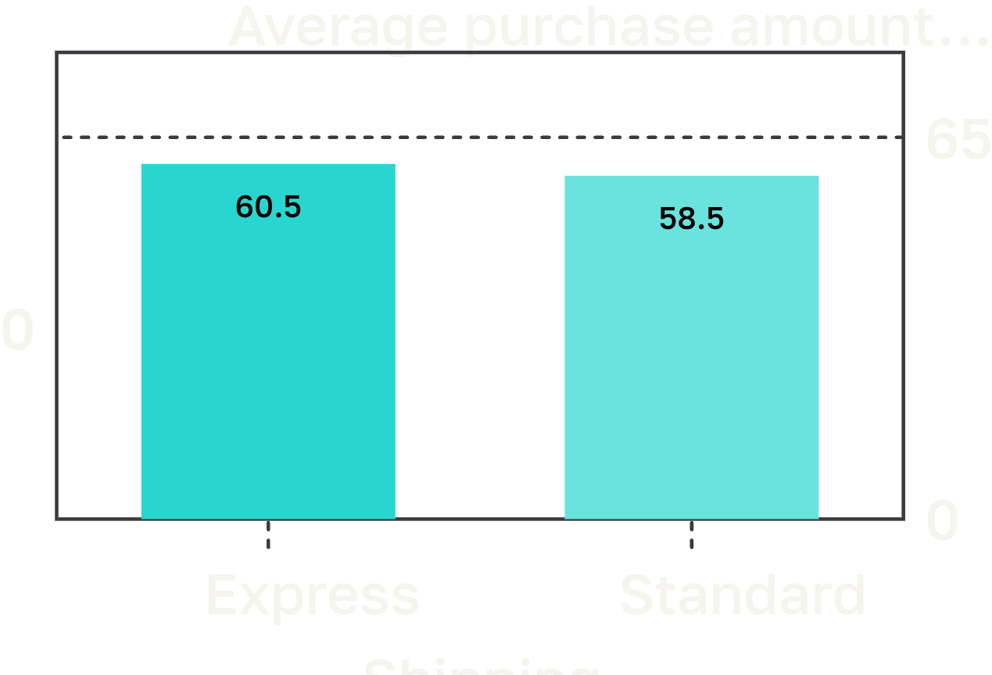
06 · PROMOTION & DELIVERY
Discounts are common, while shipping changes the ticket only slightly
43%
Highest incidence
Hat: 50.0%
Sneakers: 49.7%
of purchases include a discount
1,677 OF 3,900 PURCHASES
$2.02 DIFFERENCE
Notes:
Discounts touch nearly half of the dataset, with Hat and Sneakers leading incidence. Shipping moves the average ticket only modestly: Express is $2.02 higher than Standard.

Slide 9
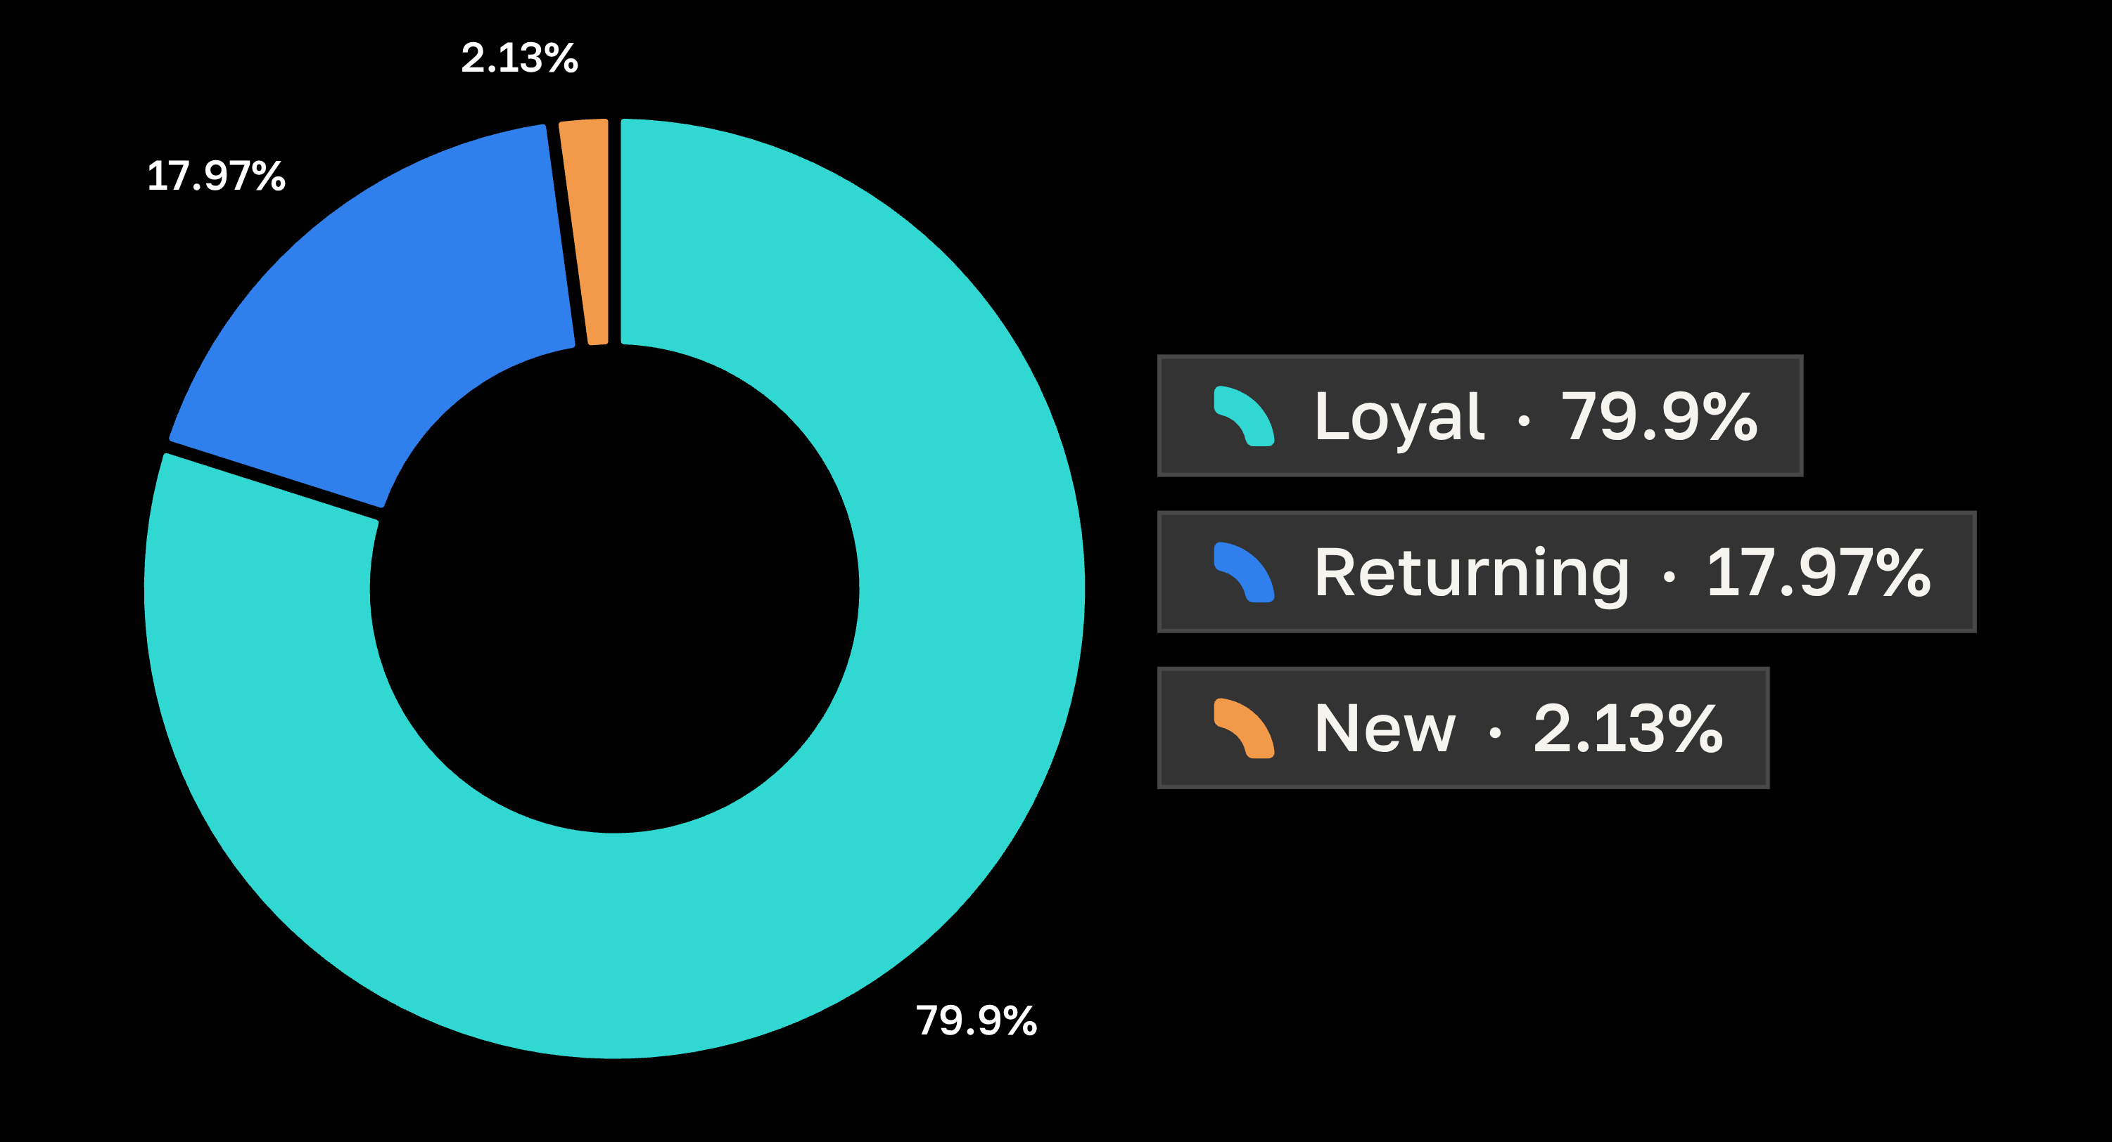
07 · LOYALTY
The customer base is already overwhelmingly Loyal
3,116 Loyal
Using previous purchases: New = 1 purchase, Returning = 2–10, Loyal = more than 10.
Protecting repeat behavior is as important as acquisition.
Notes:
Define the segments before reading the distribution. The business read is clear: this base already contains strong repeat behavior, so the next opportunity is not only acquisition.

Slide 10
08 · PORTFOLIO CLOSE
The portfolio move: connect the query to the decision
TEST NEXT
GUARDRAILS
RETENTION
Subscription offers
Category discounts
High-purchase customers
Tie them to frequency.
Set category-specific limits.
Sharpen the messaging.
What this project demonstrates: turning raw customer data into clear metrics, structured SQL, visual storytelling and business recommendations.
AN ANALYSIS IS STRONGEST WHEN EVERY CHART ENDS WITH A DECISION, A TEST OR A NEXT QUESTION.
Notes:
Close by connecting the analysis to three practical tests. The portfolio value is the full chain: raw data, SQL structure, visual storytelling and a decision-oriented recommendation.

